Slide 1
Using a generative-adversarial neural network to generate subjectively attractive human faces
Kim Mikhail Alekseevich
Financial University under the Government of the Russian Federation

Slide 2
Introduction
The purpose of the work is to develop a machine learning model capable of generating subjectively attractive human faces, as well as comparing it with pre-trained models.
Tasks:
Analysis of literature on existing methods of generating images of people's faces.
Building and training a model based on the GCN architecture
Building software for implementing the resulting models. Implementation of the DCGAN-based model.
Implementation of the DCGAN-based model.
Implementation of the NVIDIA StyleGAN3 model.
Evaluation and comparison of the quality of generation of the resulting models in accordance with the purpose of the work.

Slide 3
Relevance
The relevance of the work is determined by the need to study the process of forming a person's assessment of the attractiveness of people's faces and to identify individual factors influencing this indicator.
Application:
Research in the field of psychology.
Visualization of voice assistants and software.
The cosmetics and plastic surgery industry.
The entertainment industry.
Dating apps.
Marketing.

Slide 4
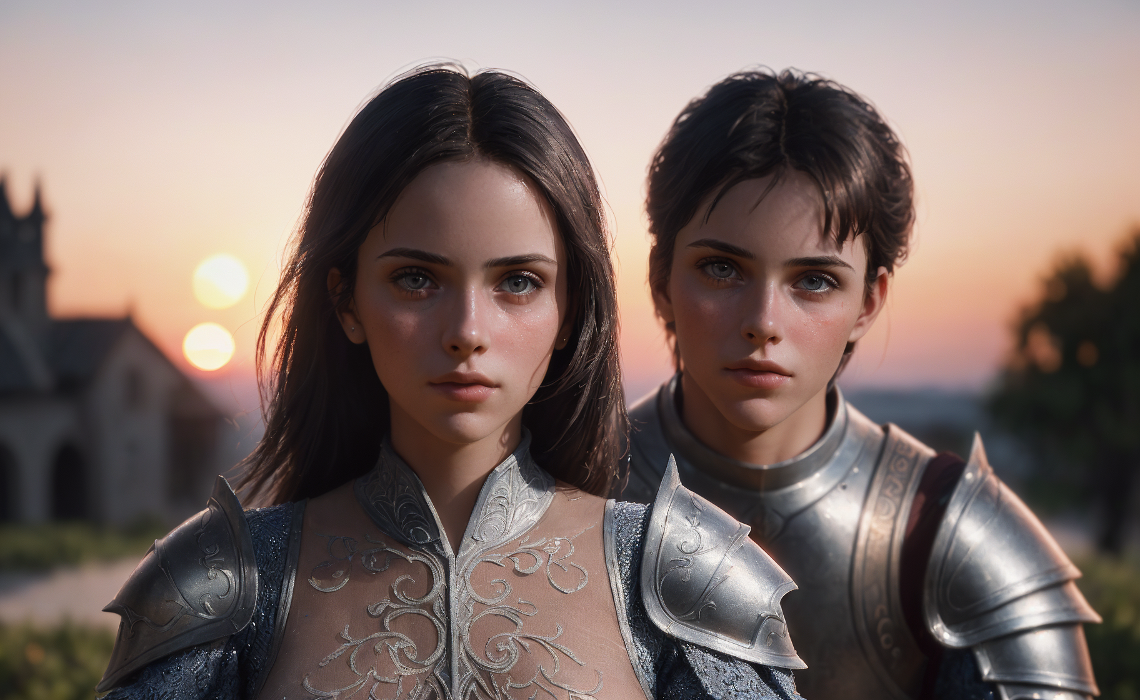
The structure of the work
Chapter 1. Problem statement, overview of application areas.
Chapter 2. Consideration of modern methods for solving the problem of generating images of people's faces.
Chapter 3. Description of the necessary theoretical principles, models and methodologies.
Chapter 4. Practical investigation of the problem solution.
Fig. 1. Stable Diffusion 1.5, DreamShaper 8, 8x_NMKD-Superscale_150000_G

Slide 5
Image generation methods
The following methods of image generation were considered in the work:
Morphing.
Autoencoders (VAE, CVAE).
Generative-adversarial neural networks (GAN, DCGAN, StyleGAN).
The following image generation methods were used in the work:
DCGAN (Deep Convolutional Generative Adversarial Network).
NVIDIA StyleGAN3.

Slide 6
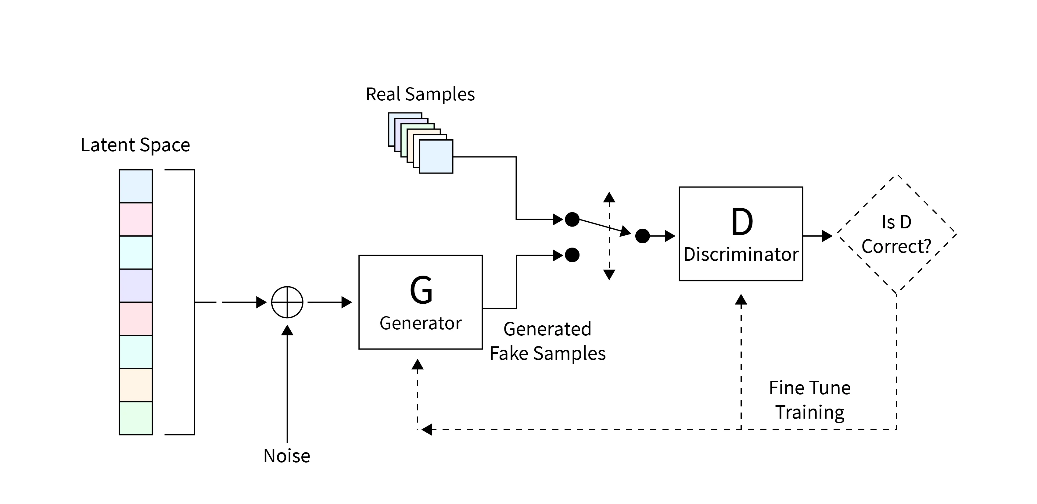
Generative-adversarial neural networks
GAN (Generative Adversarial Network):
A machine learning algorithm without a teacher.
A set of two neural networks (a generator and a discriminator) that work competitively and learn sequentially within the same epoch.
The generator creates data, aiming to simulate the distribution of real data.
The discriminator tries to distinguish the generated data from the real data.
The key idea is the formation of a quality criterion in the form of a discriminator response.
Fig. 2. General GAN architecture.

Slide 7
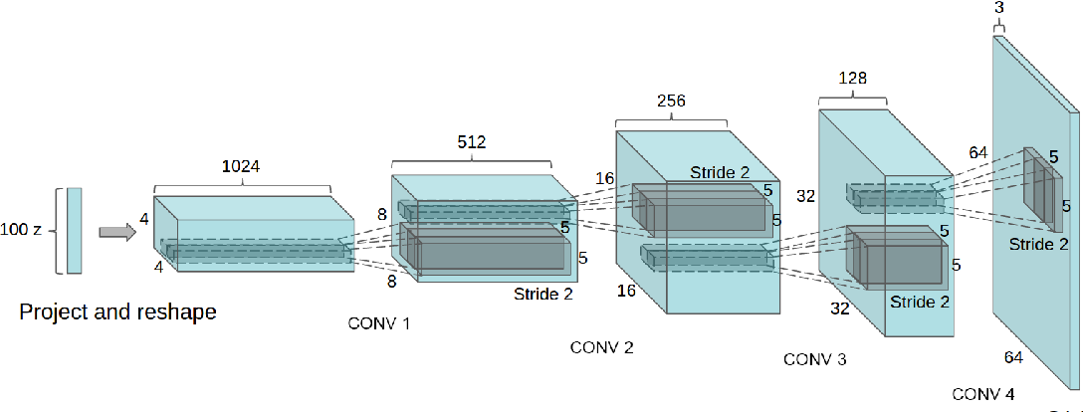
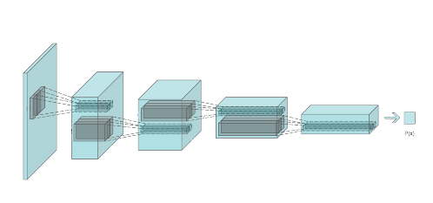
Deep convolutional generative-adversarial neural networks
DCGAN (Deep Convolutional Generative Adversarial Network):
A neural network of the GAN family.
Using "nearest upsampling" convolution layers in the generator.
Fig. 3. DCGAN generator.
Fig. 4. DCGAN discriminator.

Slide 8
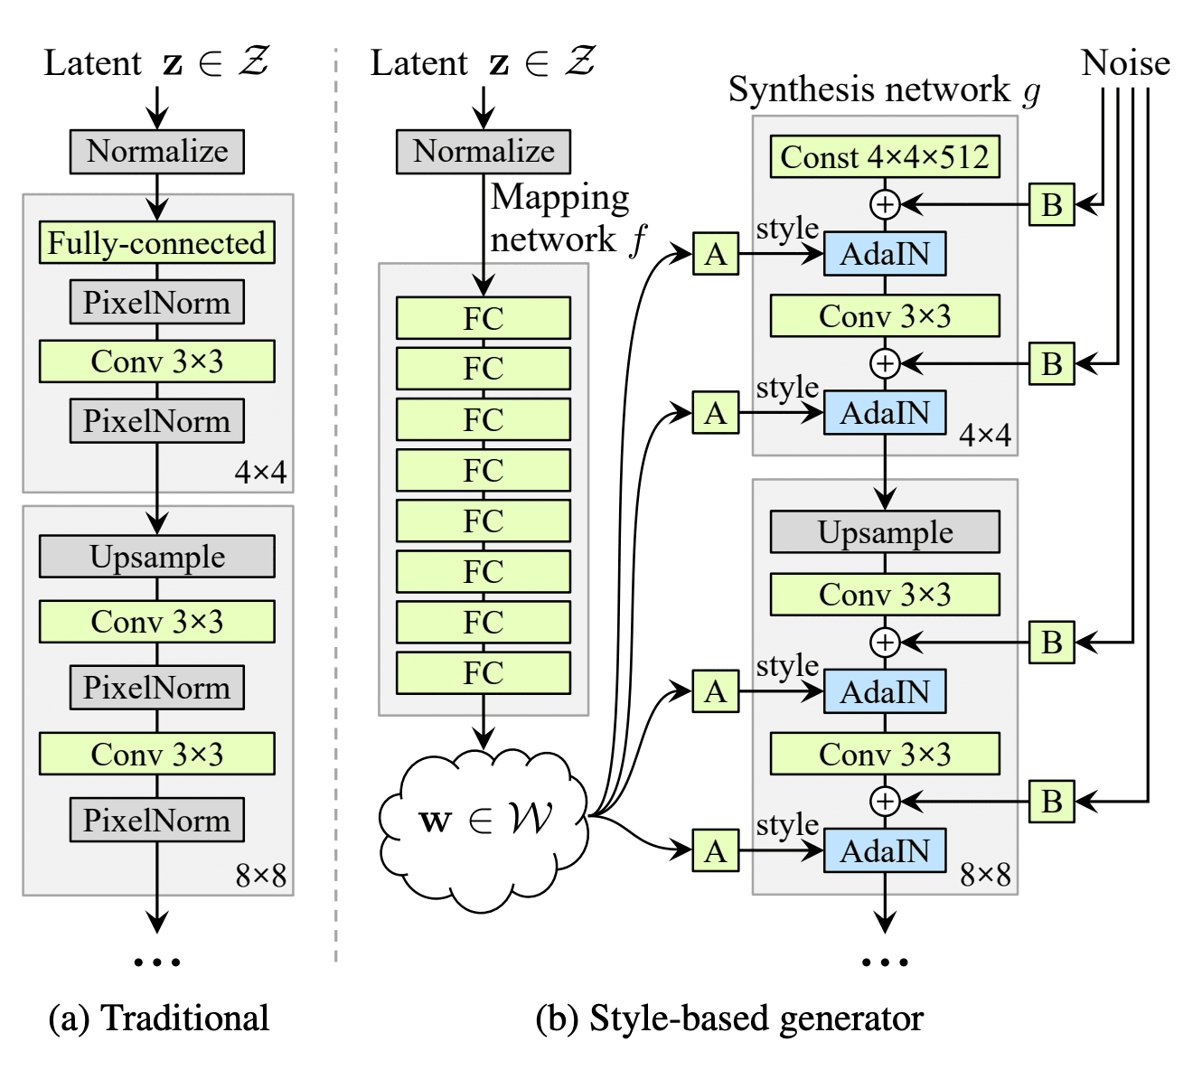
Nvidia StyleGAN Family
NVIDIA StyleGAN:
Progressive growning (ProGAN).
Applying noise to different layers of the neural network.
Adaptive instance normalization(AdaIN).
Learning a new latency space (Mapping network).
Truncation trick.
NVIDIA StyleGAN2:
Residual connections
Changing adaptive normalization.
NVIDIA StyleGAN3:
Transition equivariance
Rotation equivariance
Fig. 5. NVIDIA StyleGAN Architecture

Slide 9
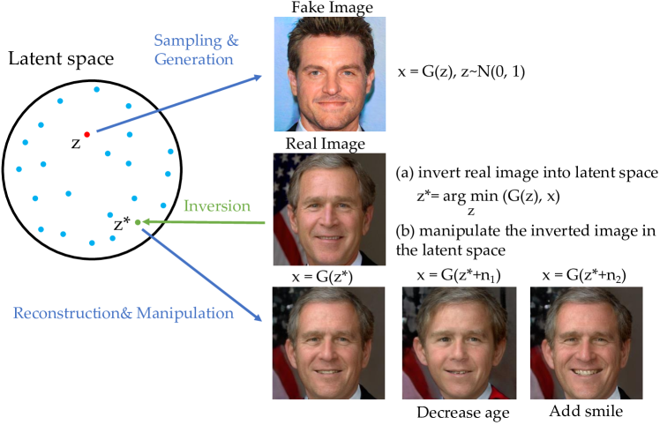
Latent space
Latent space can be defined as a multidimensional vector space in which input data elements that are similar in certain features are located close to each other in the form of hidden space vectors.
Fig. 6. Latent space research.

Slide 10
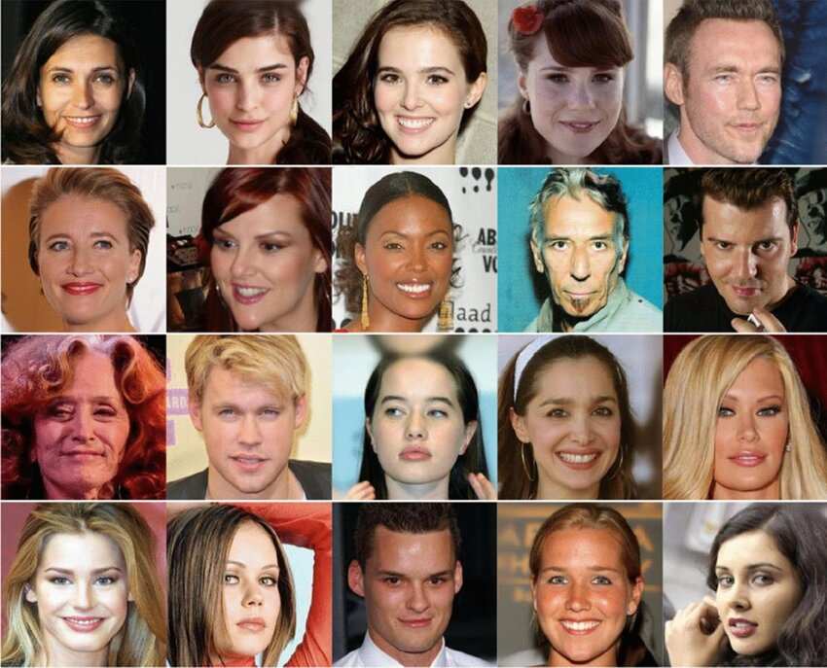
Dataset
CelebA-HQ
30,000 images of people's faces.
Resolution 1024x1024 px.
Introduced in 2017 by NVIDIA.
Based on CelebA.
Fig. 7. Examples of images from the CelebA-HQ dataset

Slide 11
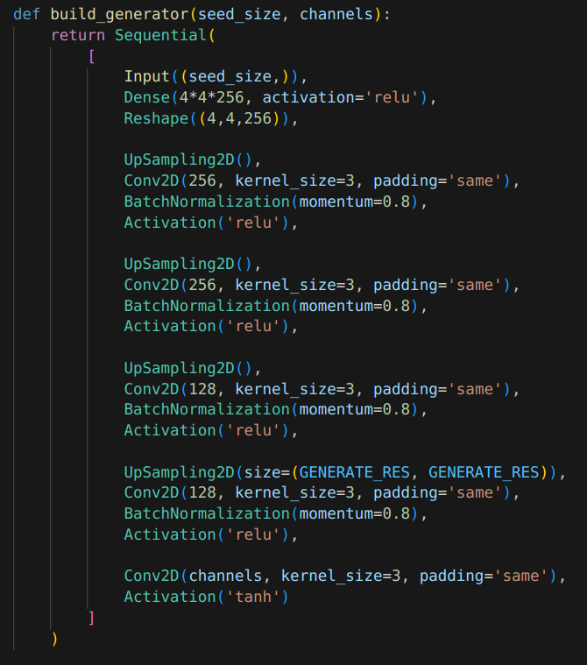
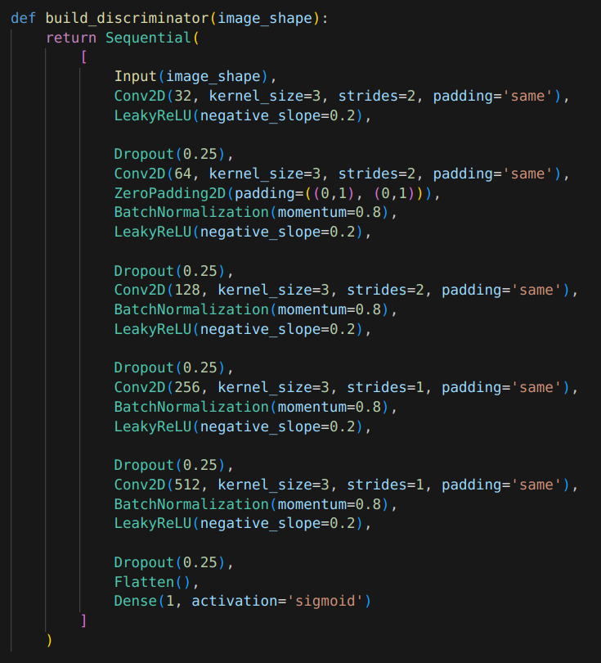
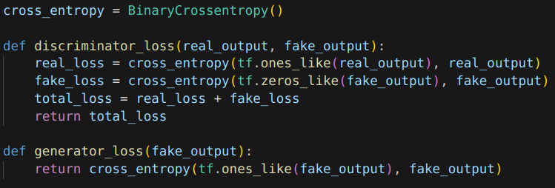
Construction and parameters of the DCGAN model
Fig. 10. Quality criteria
Fig. 11. Meta parameters
Fig. 8. Generator architecture
Fig. 9. Discriminator architecture

Slide 12
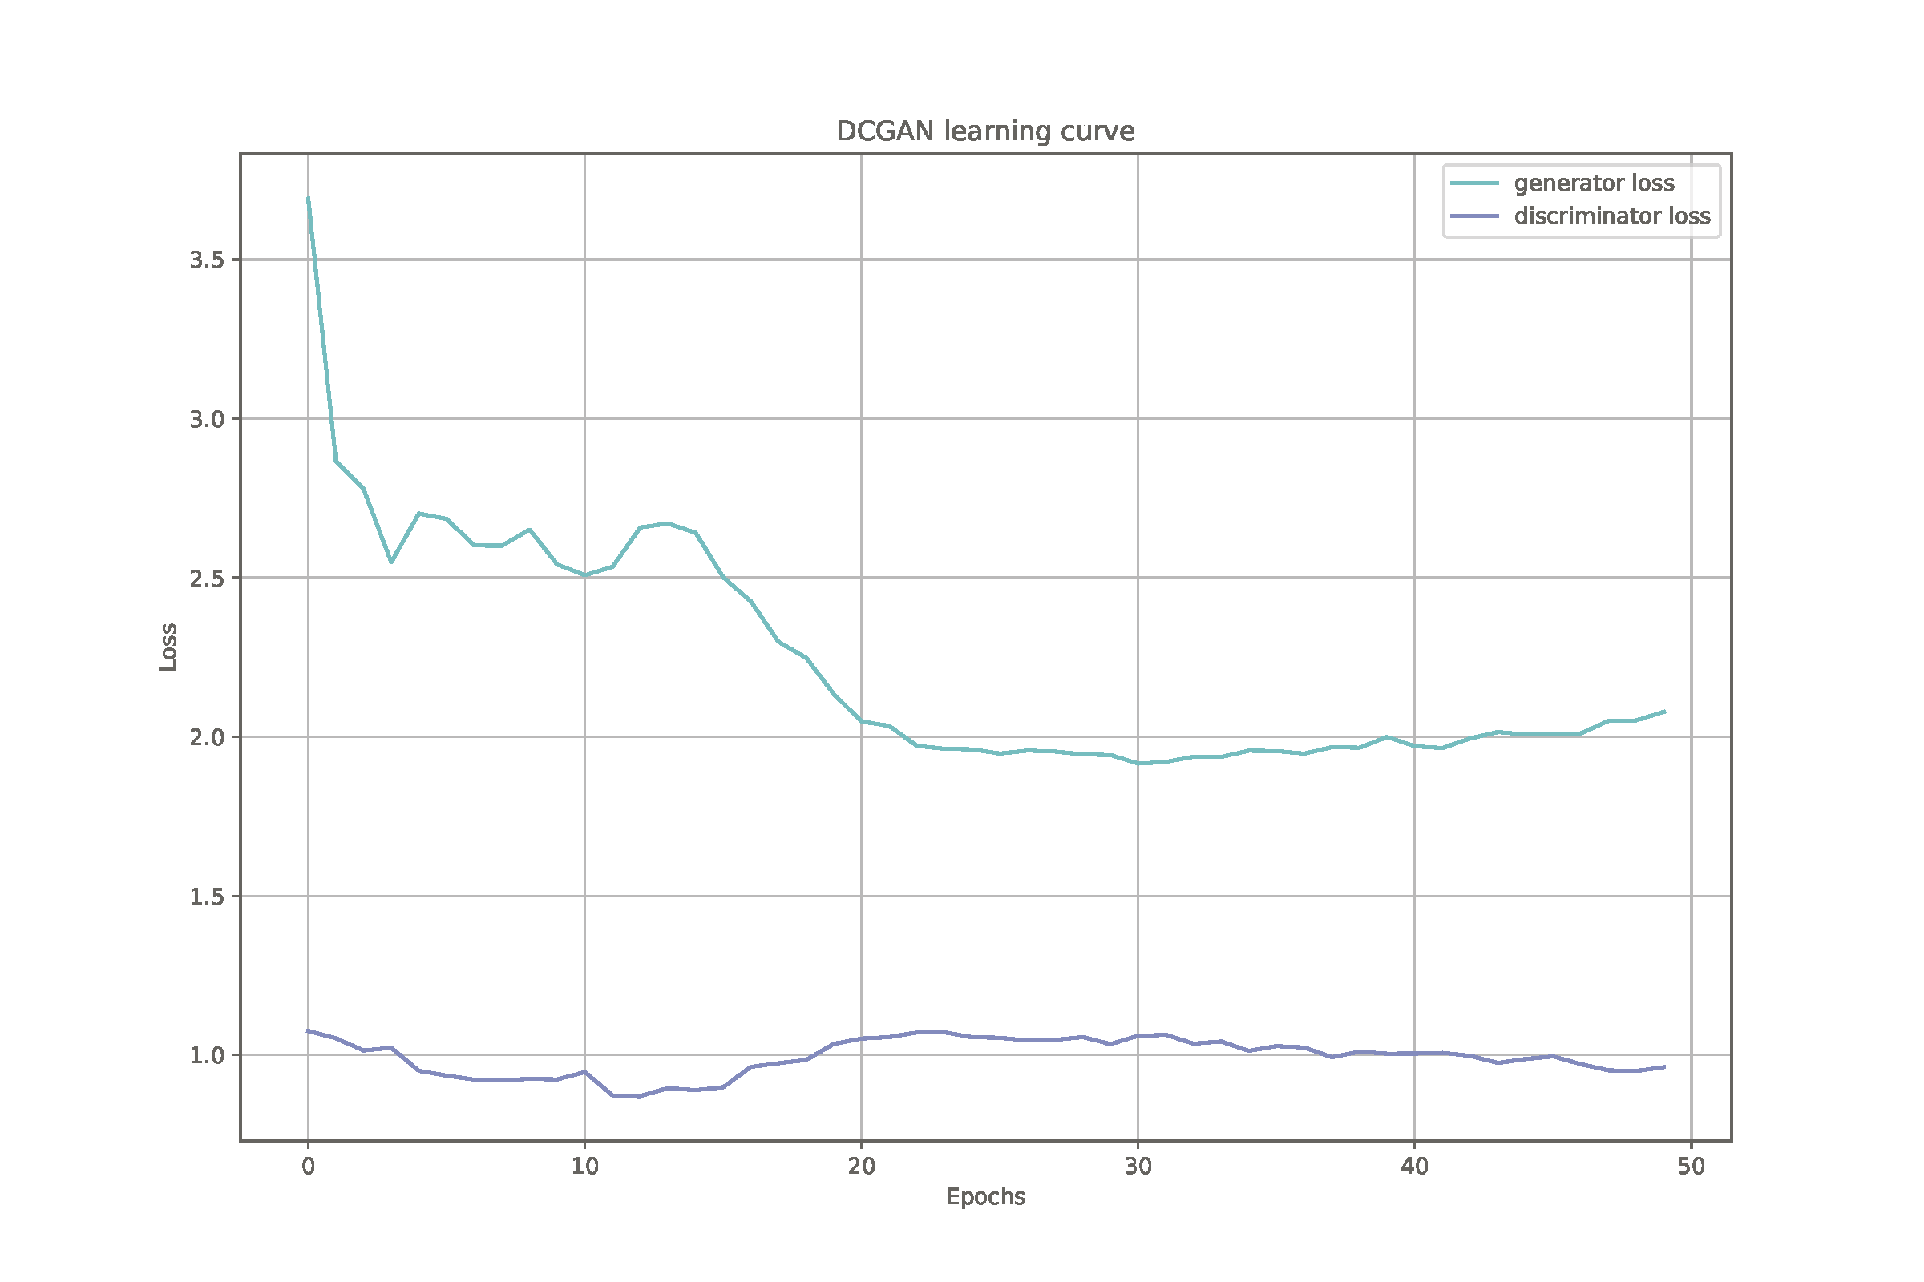
DCGAN Model Training
The loss function for the generator and discriminator is binary cross—entropy.
Fig. 12. DCGAN Model Training.

Slide 13
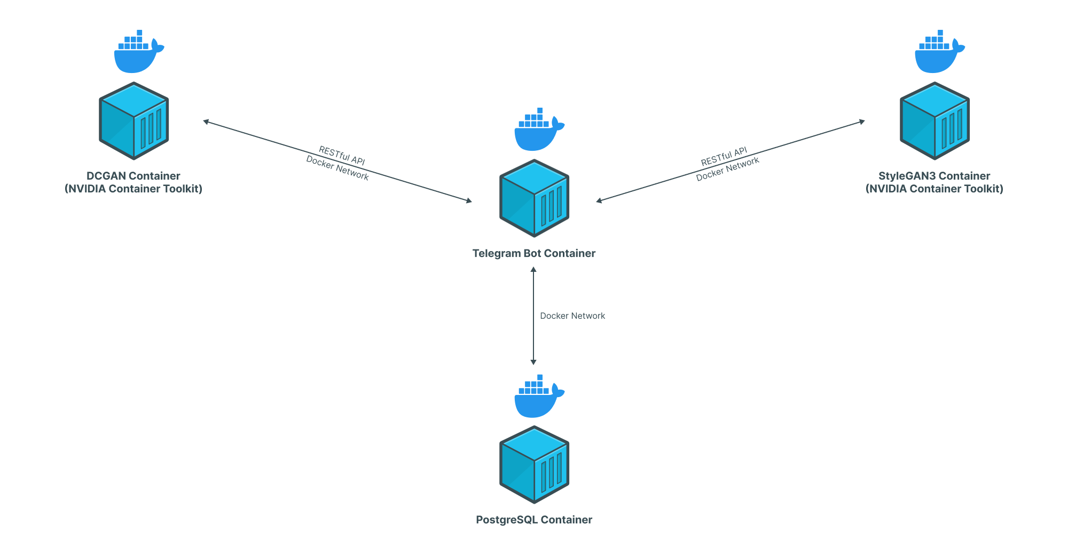
Application building
Fig. 13. Telegram bot architecture.

Slide 14
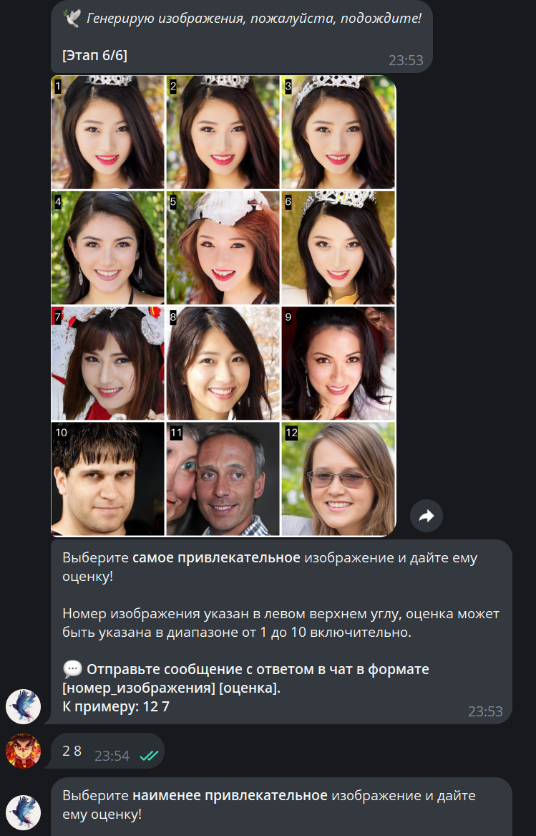
The algorithm of the recommendation system
Generation stages:
1 – 2. Generating random images
3 – 6. Generation according to the recommendation system
Recommendation system :
For random generation, a random vector is used, the elements of which follow a normal distribution ($m=0$, $d=1$).
For other generation, the weighted average value of the hidden space vector is used.
The coefficient for the vector is found by the formula $a^{x}$, where $a=const=1.5$, $x=\overline{1,10}$ — user evaluation of an attractive image.
Noise is added for each vector to generate.
Fig. 14. StyleGAN3 usage in bot.

Slide 15
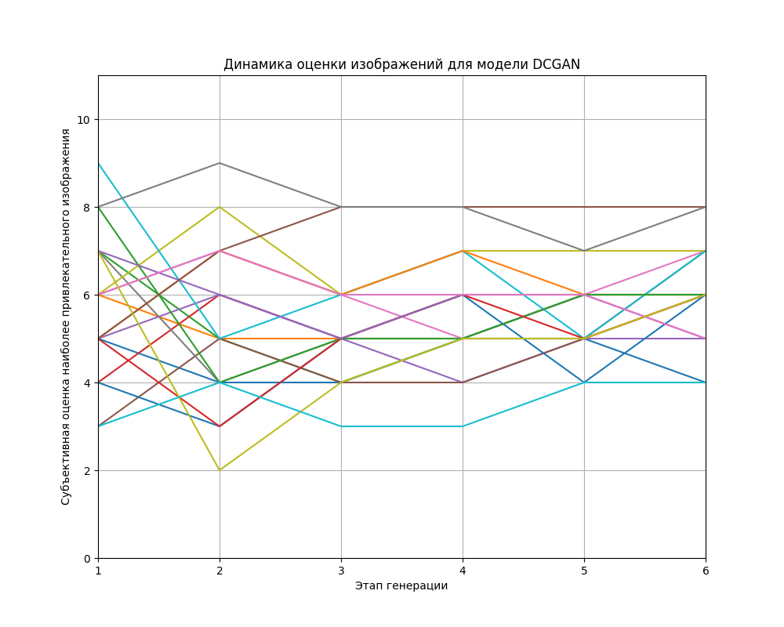
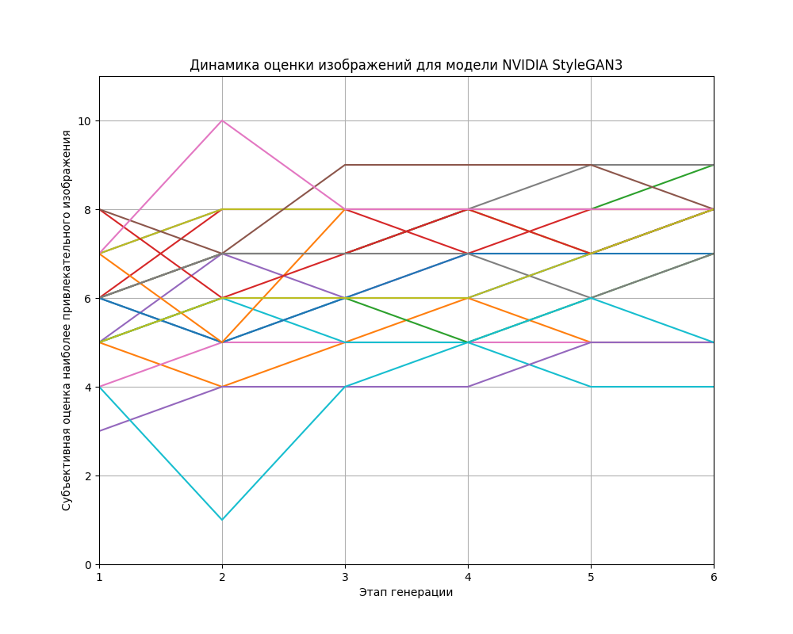
Conducting research
The sample consists of 20 people.
Fig. 15. Dynamics of image evaluation for the DCGAN model
Fig. 16. Dynamics of image evaluation for the NVIDIA StyleGAN3 model

Slide 16
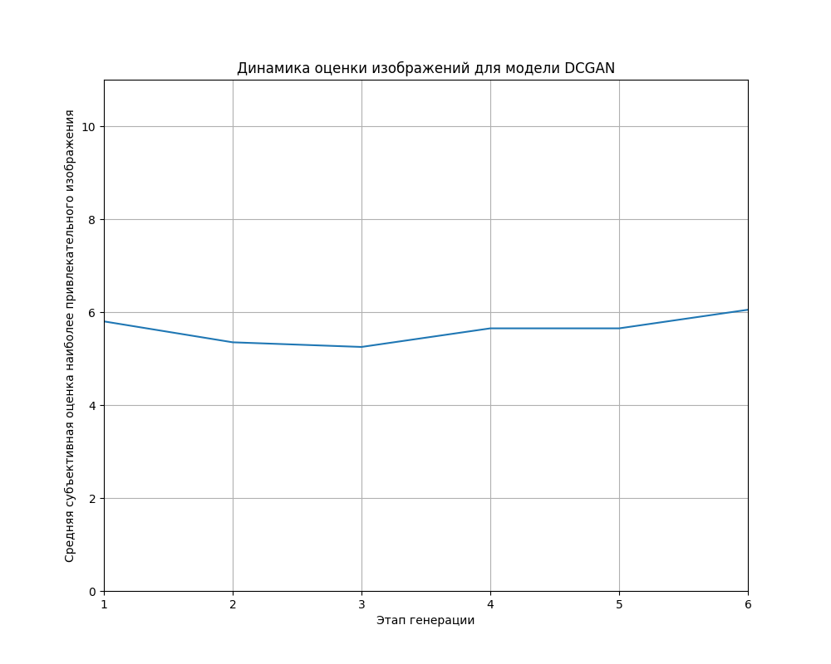
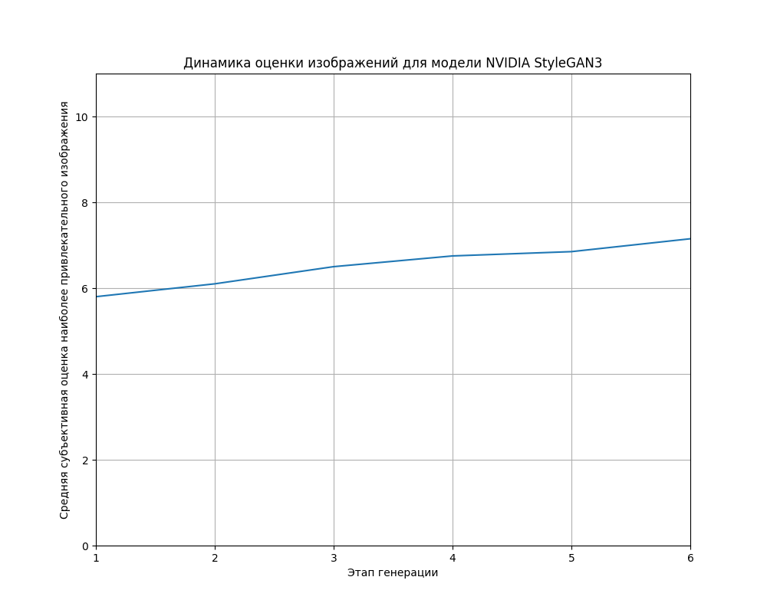
Evaluating models
Avg DCGAN(1): 5.8 Avg DCGAN(2): 5.35 Avg DCGAN(1,2): 5.575 Avg DCGAN(6): 6.05 $Δ$(avg DCGAN(1,2), avg DCGAN(6)): 0.475
Avg DCGAN(1): 5.8 Avg DCGAN(2): 6.1 Avg DCGAN(1,2): 5.95 Avg DCGAN(6): 7.15 $Δ$(avg DCGAN(1,2), avg DCGAN(6)): 1.2
Fig. 17. Dynamics of the average image score for the DCGAN model
Fig. 18. Dynamics of the average image rating for the NVIDIA StyleGAN3 model

Slide 17
Conclusions
The actual task of generating subjectively attractive people's faces is considered.
A number of GAN-based architectures are considered.
A method of generating subjectively attractive people's faces has been developed.
Experiments have been conducted that have shown the promise of using GAN in the field of generating subjectively attractive human faces.
Further research is planned to improve the quality of generation and improve the accuracy of the recommendation system.

